Slide 1



Project no.
Project Proposal
Title: SPORTS ANIME
Zeny Pauline Salinas
Powered by

Slide 2


Project Description
Briefly introduce the project - sports anime is an activity involving physical energy and skill in which one person or a group competes against another or others for amusement. It is also well known in Japanese manga and anime genre that focuses on stories and other athletic and competitive pursuits.
Who is the target end user? -people who are interested in anime sports through online means.
What are the objectives? –the objectives are for entertainment and updates and incoming seasons for the upcoming anime and manga.
Powered by

Slide 3
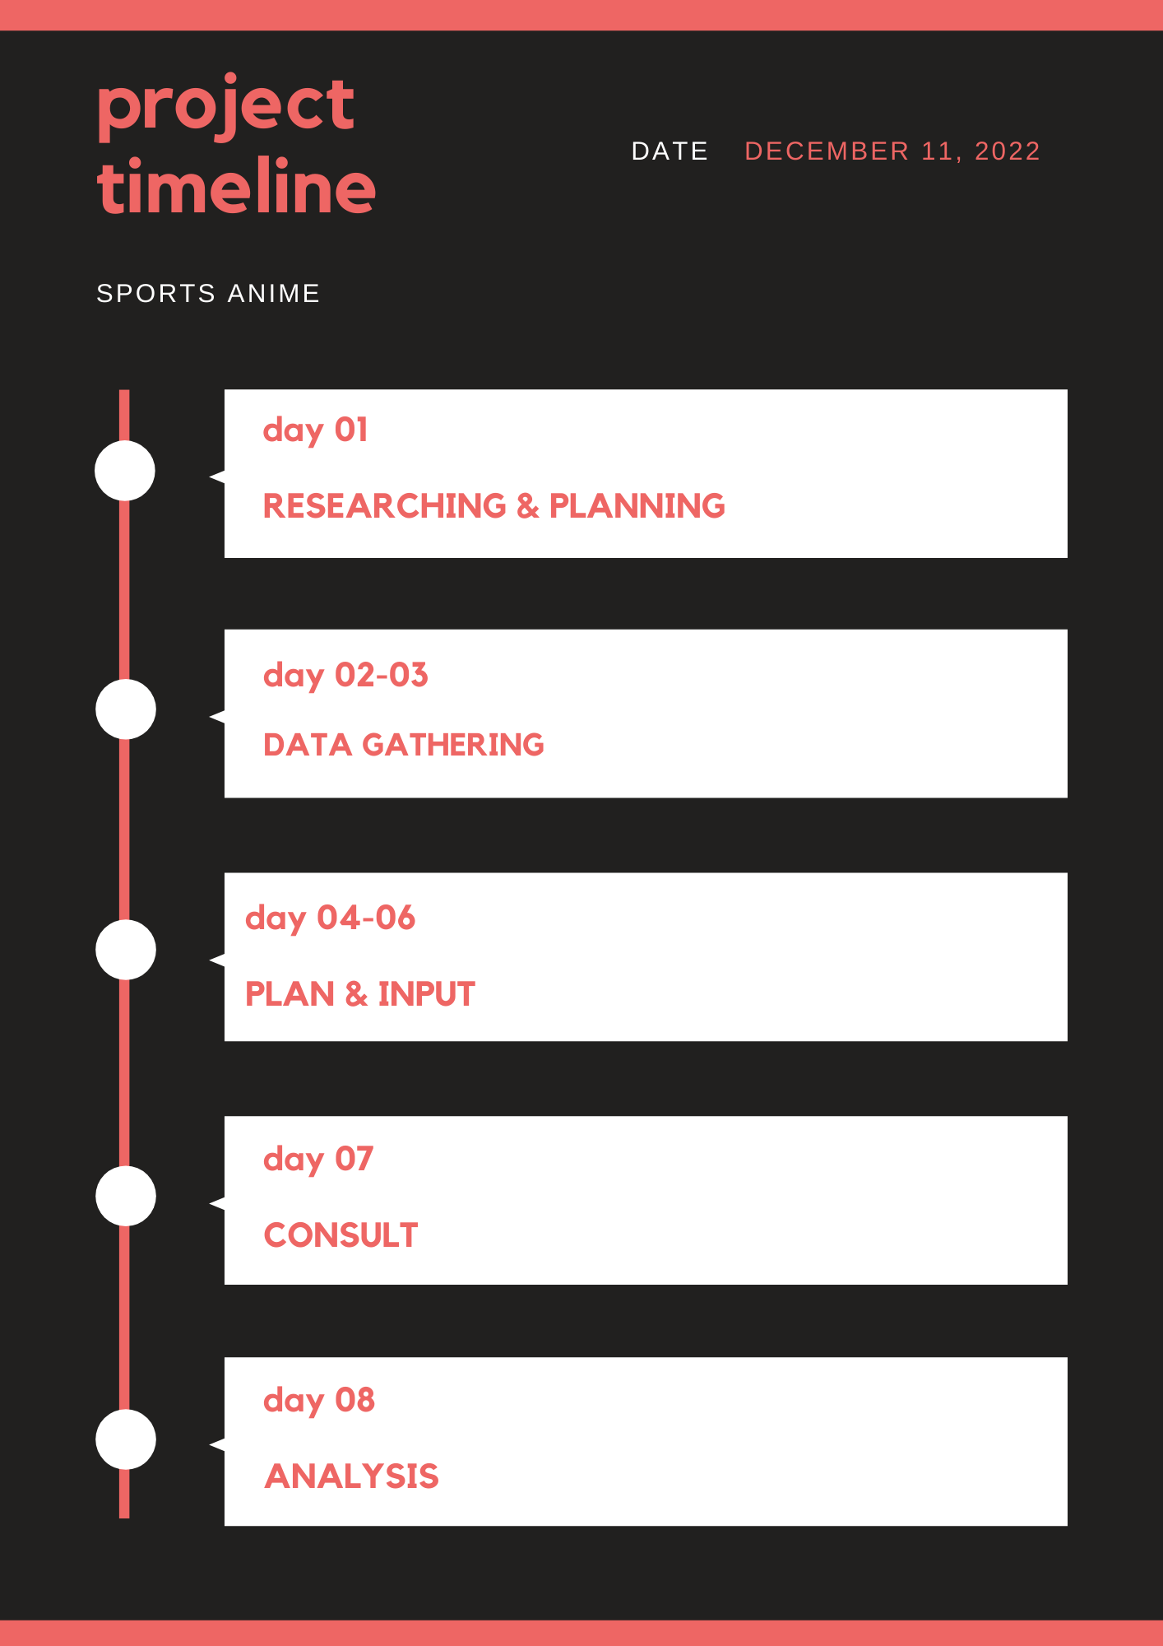
Define Deliverables and Goals
Present the project timeline
Set goals that align with the deliverables you’re producing
Powered by

Slide 4
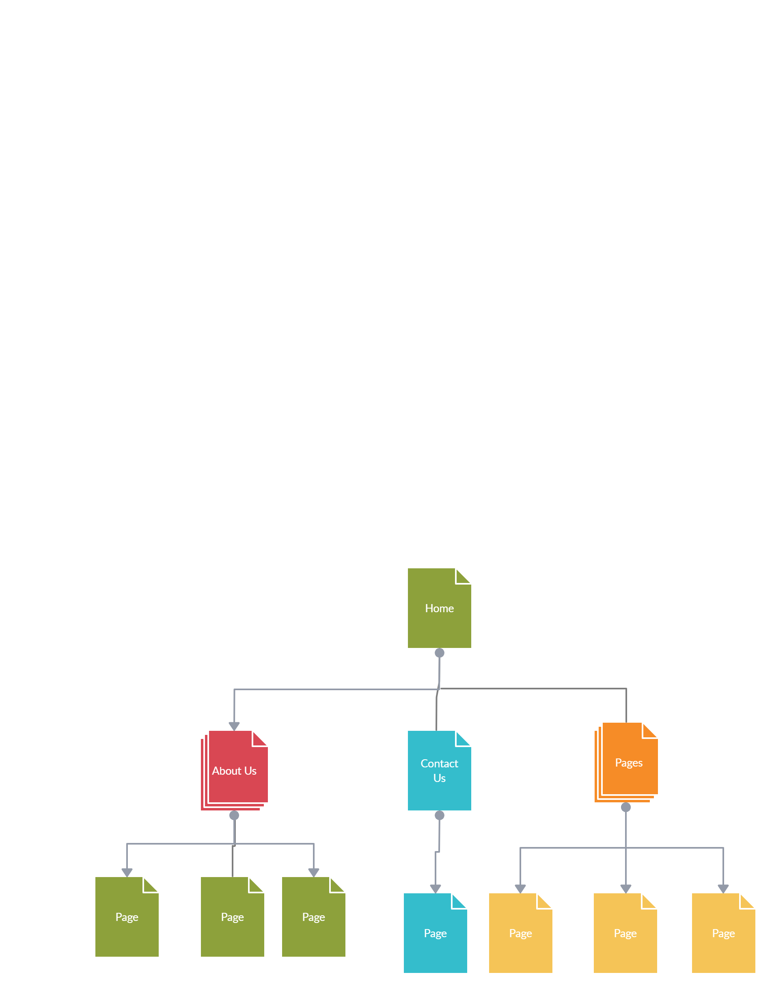
Hierarchical Sitemap of your Website
Information architecture of a website
Visual representation of the site’s organization and how different sections are linked together.
Powered by

